Slide 1
The introduction of fuzzy control toolbox
Group member&content
王云涛 Overview of fuzzy logic toolbox
房体强 Foundations of Fuzzy Logic
郑明航 Fuzzy Inference Systems
韦亚杰 Building Systems with the Fuzzy
Logic Toolbox

Slide 2
A
What Is the Fuzzy Logic Toolbox?
Catalog
What Can the Fuzzy Logic Toolbox Do?
B
C
An Introductory Example: Fuzzy vs. Non-Fuzzy

Slide 3
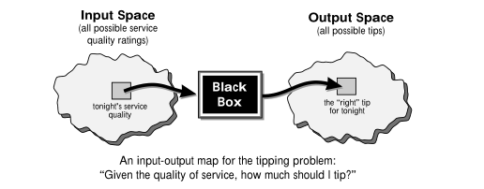
1
What Is the Fuzzy Logic Toolbox?
What Is Fuzzy Logic?
Fuzzy logic is a convenient way to map an input space to an output space.
the great emphasis here is on the
word “convenient.”

Slide 4
1
What Is the Fuzzy Logic Toolbox?
Why use fuzzy logic？
01
Fuzzy logic is conceptually easy to understand.
02
Fuzzy logic is flexible.
03
Fuzzy logic is tolerant of imprecise data.
Fuzzy logic can model nonlinear functions of arbitrary complexity.
04

Slide 5
1
What Is the Fuzzy Logic Toolbox?
Why use fuzzy logic？
05
Fuzzy logic can be built on top of the experience of experts.
Fuzzy logic can be blended with conventional control techniques.
06
07
Fuzzy logic is based on natural language.

Slide 6
1
What Is the Fuzzy Logic Toolbox?
1
a collection of functions built on the MATLAB numeric computing environment.
provides tools for you to create and edit fuzzy inference systems within the framework of MATLAB
2
integrate fuzzy systems into simulations with Simulink or build stand-alone C programs that call on fuzzy systems you build with MATLAB
3

Slide 7
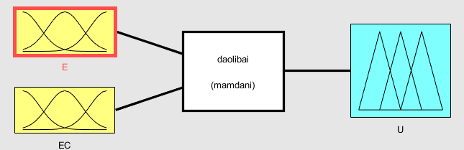
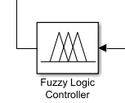
1
What Is the Fuzzy Logic Toolbox?
The toolbox provides three categories of tools:
A
Command line functions
view the MATLAB code:
type function_name
B
Graphical, interactive tools
C
Simulink blocks and examples

Slide 8
2
What Can the Fuzzy Logic Toolbox Do?
run your own stand-alone C programs
test your fuzzy system
in simulink
02
03
01
04
create and edit fuzzy inference systems
create your own tools to customize the Fuzzy Logic Toolbox or harness it with another toolbox

Slide 9
3
An Introductory Example: Fuzzy vs. Non-Fuzzy
Given numbers between 0 and 10 (where 10 is excellent) that represent the quality of the service and the quality of the food,
respectively, at a restaurant, what should the percentage of tipping be?
Compare in two ways：Non-fuzzy & fuzzy

Slide 10
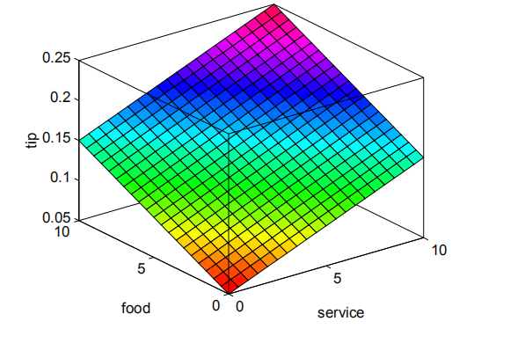
3
An Introductory Example: Fuzzy vs. Non-Fuzzy
The Non-Fuzzy Approach：
Here's one attempt :tip=0.20/20*(service+food)+0.05;

Slide 11
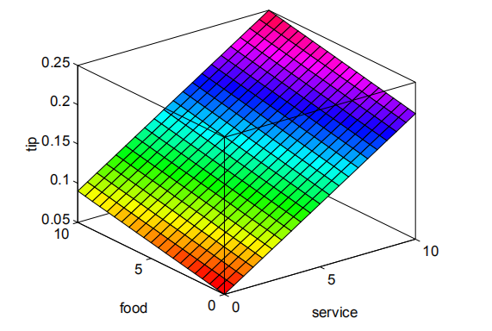
3
An Introductory Example: Fuzzy vs. Non-Fuzzy
suppose that I want the service to account for 80% of the overall tipping “grade”and I'll let the food make up the other 20%.
servRatio=0.8;
tip=servRatio*(0.20/10*service+0.05) + ...
(1–servRatio)*(0.20/10*food+0.05);
But still the response is somehow too linear all the way around.

Slide 12
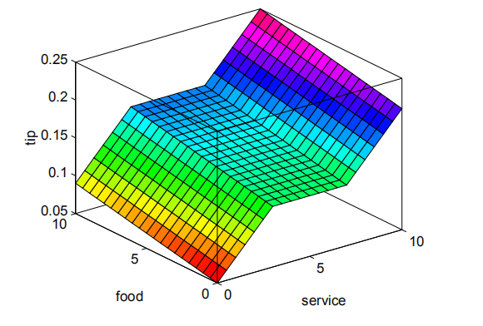
3
An Introductory Example: Fuzzy vs. Non-Fuzzy
servRatio=0.8;
if service<3,
tip=((0.10/3)*service+0.05)*servRatio + ...
(1–servRatio)*(0.20/10*food+0.05);
elseif service<7,
tip=(0.15)*servRatio + ...
(1–servRatio)*(0.20/10*food+0.05;
else,
tip=((0.10/3)*(service–7)+0.15)*servRatio + ...
(1–servRatio)*(0.20/10*food+0.05);
end
But it was a little tricky to code this correctly, and it's definitely not easy to modify in the future.

Slide 13
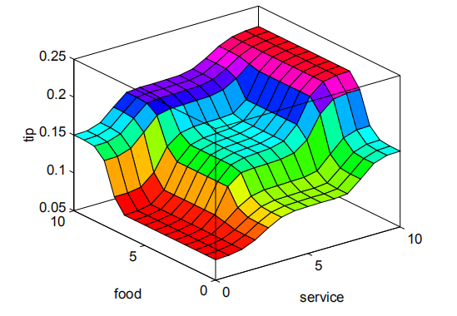
3
An Introductory Example: Fuzzy vs. Non-Fuzzy
The Fuzzy Approach： if-then sentence
1. if service is poor or the food is rancid then tip is cheap
2. if service is good then tip is average
3. if service is excellent or food is delicious then tip is generous

Slide 14
THANK YOU
谢谢观看
2018.11

